Slide 1

Insights Squad
Sakshi Awal
Shilpa Nidhi
Dhwani Ojha
Rutuja Patole

Slide 2

Ground Game Health
Ground Game Health is a health and wellness company that focuses on providing holistic and comprehensive solutions to improve individuals' physical, mental, and emotional well-being. The company adopts a multifaceted approach to health, encompassing various aspects such as nutrition, fitness, mindfulness, and lifestyle modifications.

Slide 3
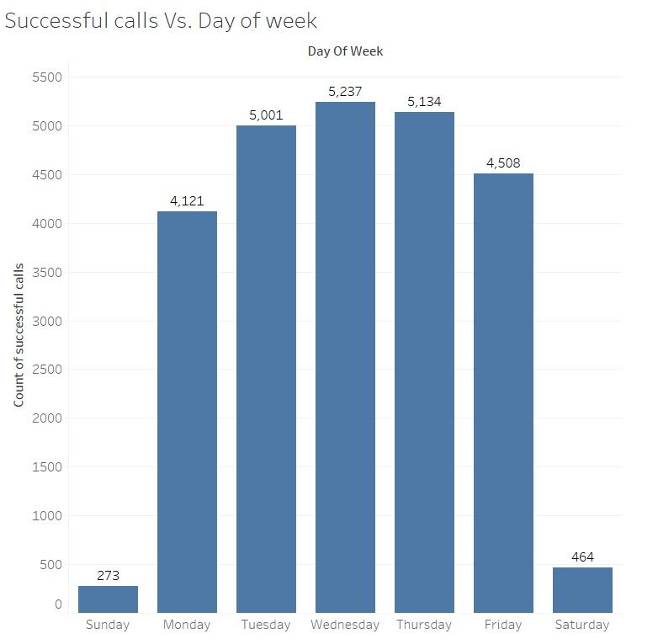
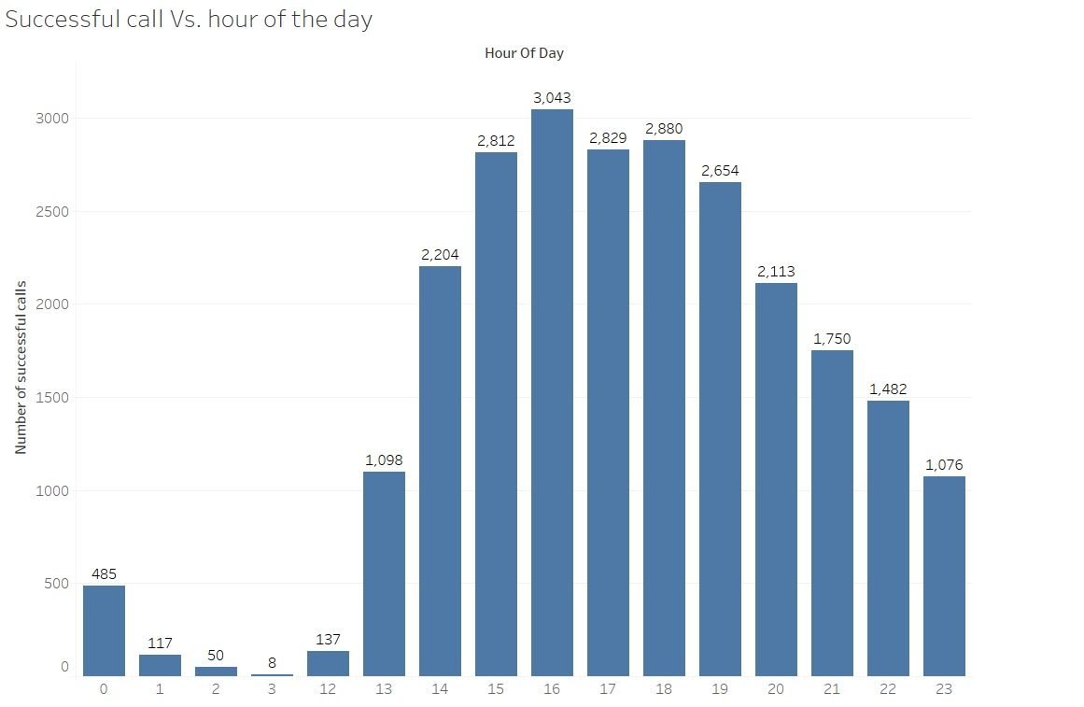
Successful Calls
As we can see, most calls were successful when made mid week between 3-7pm. Probably because mid-week, particularly Wednesday and Thursday, tends to be less hectic for many individuals compared to Mondays or Fridays. People may be more receptive to calls during these days as they are settled into their weekly routines but not yet anticipating the weekend.

Slide 4
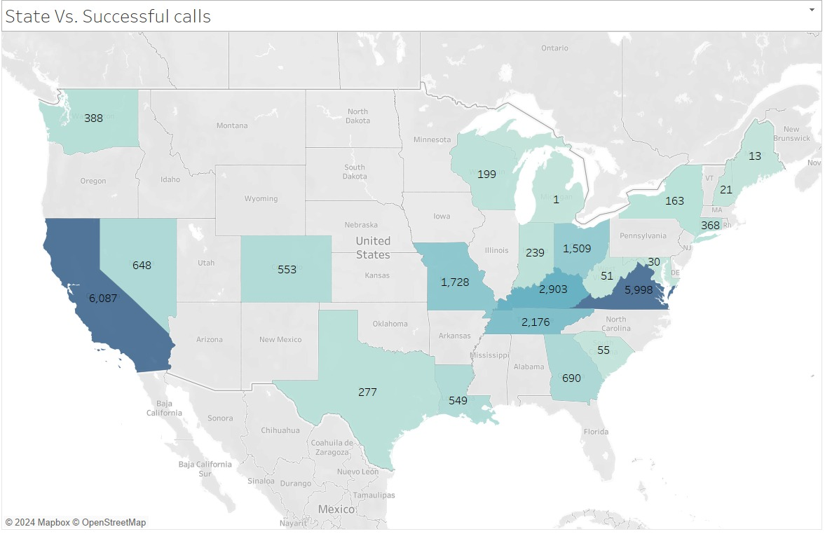
Successful calls based on states.
As we can see, most successful calls took place in California and Virginia.
Here are the possible reasons why-
CA and VA may have higher demand for health and wellness services or products, leading to greater receptiveness to Ground Game Health's offerings. These regions might also have a more health-conscious population or a higher level of awareness about holistic health practices, making them more likely to respond positively to the company's messaging.
The company's marketing and messaging strategies may be tailored to resonate specifically with the preferences, lifestyles, and values of consumers in CA and VA. Understanding the unique characteristics of these regions allows Ground Game Health to customize its approach and effectively communicate the benefits of its offerings to local audiences.

Slide 5
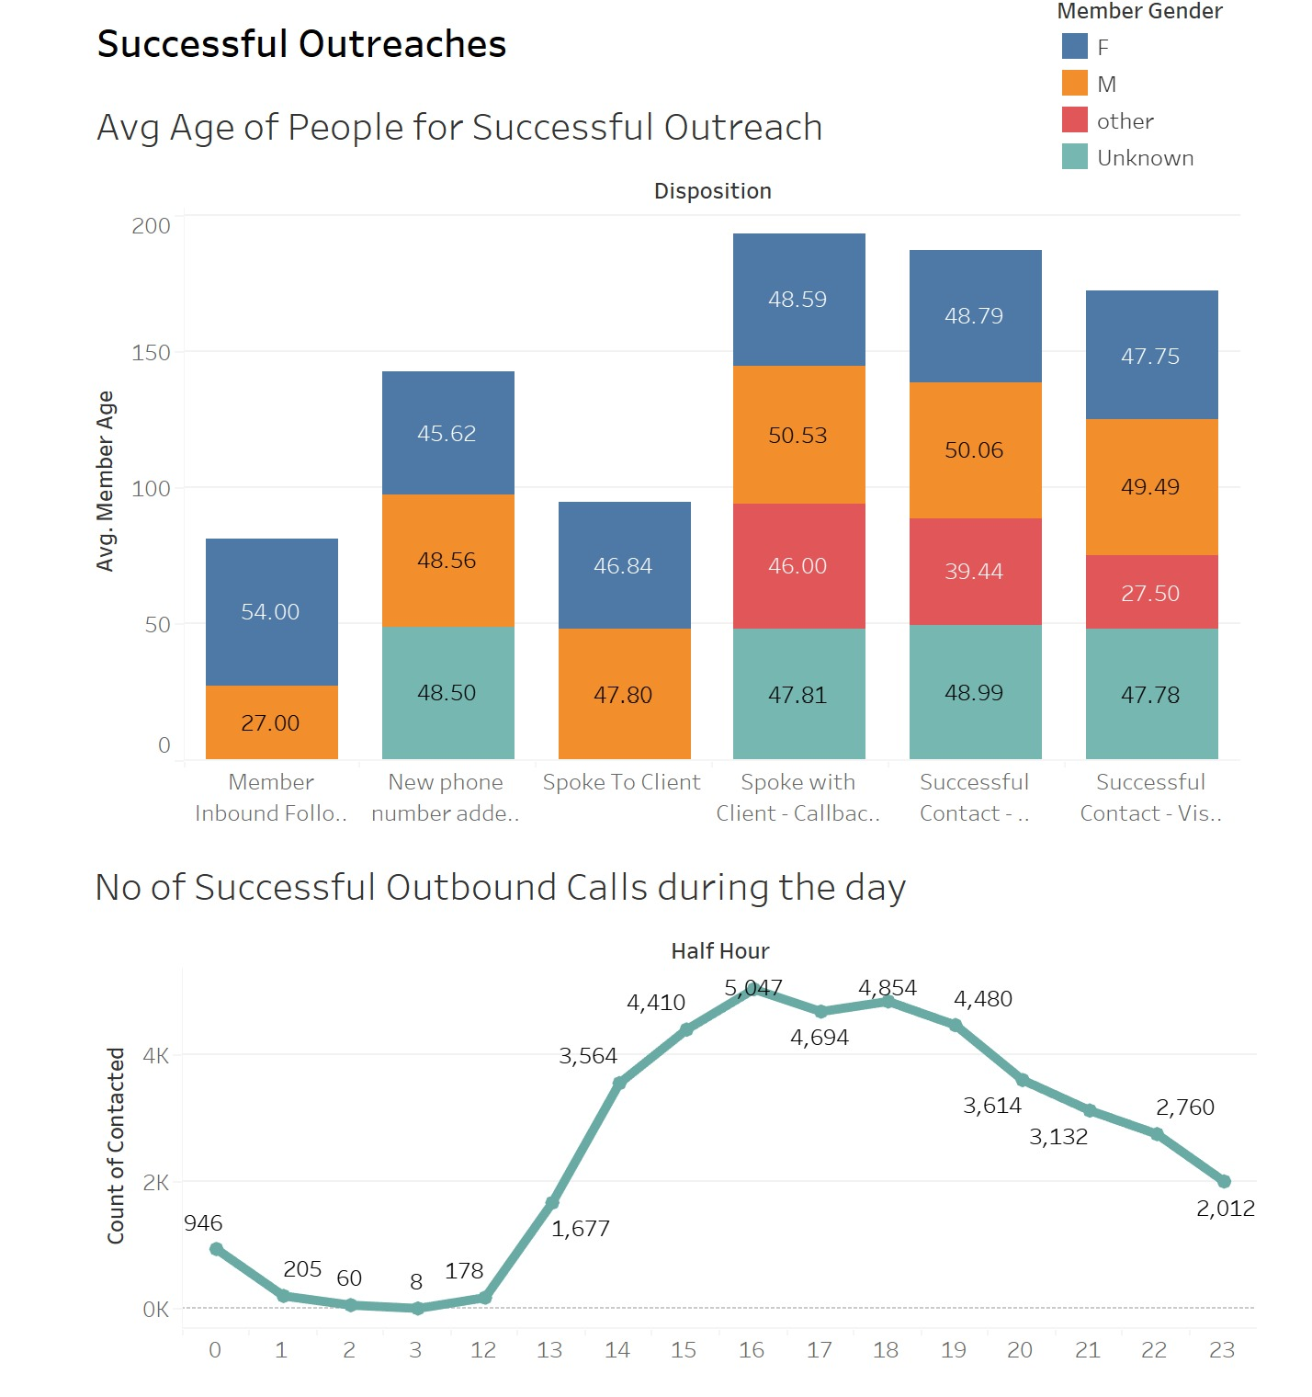
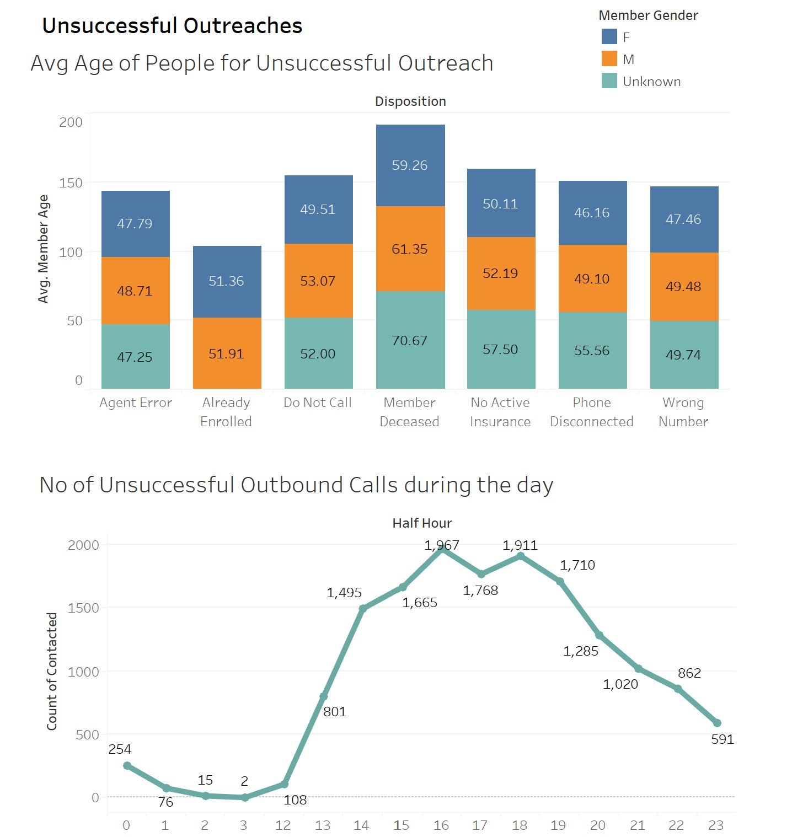
Successful vs Unssuccessful Outreaches
The average for Successful Outreach is in the age range of 40-50 contacted between 2-4pm.
The average of Unsuccessful Outreach is also in the age range of 40-50 with most reason being “Member Deceased”.

Slide 6
Recommendations
Focus outreach efforts on the 40-50 age group for higher success rates because they may become more proactive about preventive health measures to avoid chronic diseases and maintain a high quality of life. Ground Game Health may offer preventive health programs, screenings, and wellness services that appeal to this demographic.
Schedule outreach activities between 2-4pm for increased engagement.
Provide compassionate support for situations of "Member Deceased" outreach.
Utilize digital platforms alongside phone calls to expand outreach reach.
Monitor metrics regularly to refine strategies and allocate resources effectively.
Collect feedback to understand preferences and enhance outreach strategies.
Ground Game Health can develop a targeted regional expansion strategy focused on penetrating similar high-potential markets. This may involve conducting market research to identify regions with demographics and lifestyle trends resembling those of CA and VA, followed by strategic location scouting and market entry.
Continuously innovate and diversify the company's product and service offerings based on customer feedback and market trends. Ground Game Health can introduce new programs, classes, or wellness services tailored to meet the specific needs and preferences of customers in different regions.

